Slide 1
INCENTIVES SCHEMES TO PROMOTE IMPROVED ROAD USER BEHAVIOUR
Presenter: Katlego Bolsiek

Slide 2
CONTRIBUTORY FACTORS
2018
3-year comparison

Slide 3
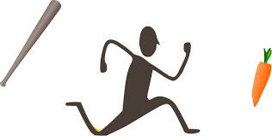
Motivational Approach
Carrot and Stick Approach
The "carrot and stick" approach refers to a policy of offering a combination of reward and punishment to induce good behavior.
Motivate drivers to abide by road laws and offer rewards as a process of encouraging and establishing a pattern of good road user behaviour.

Slide 4
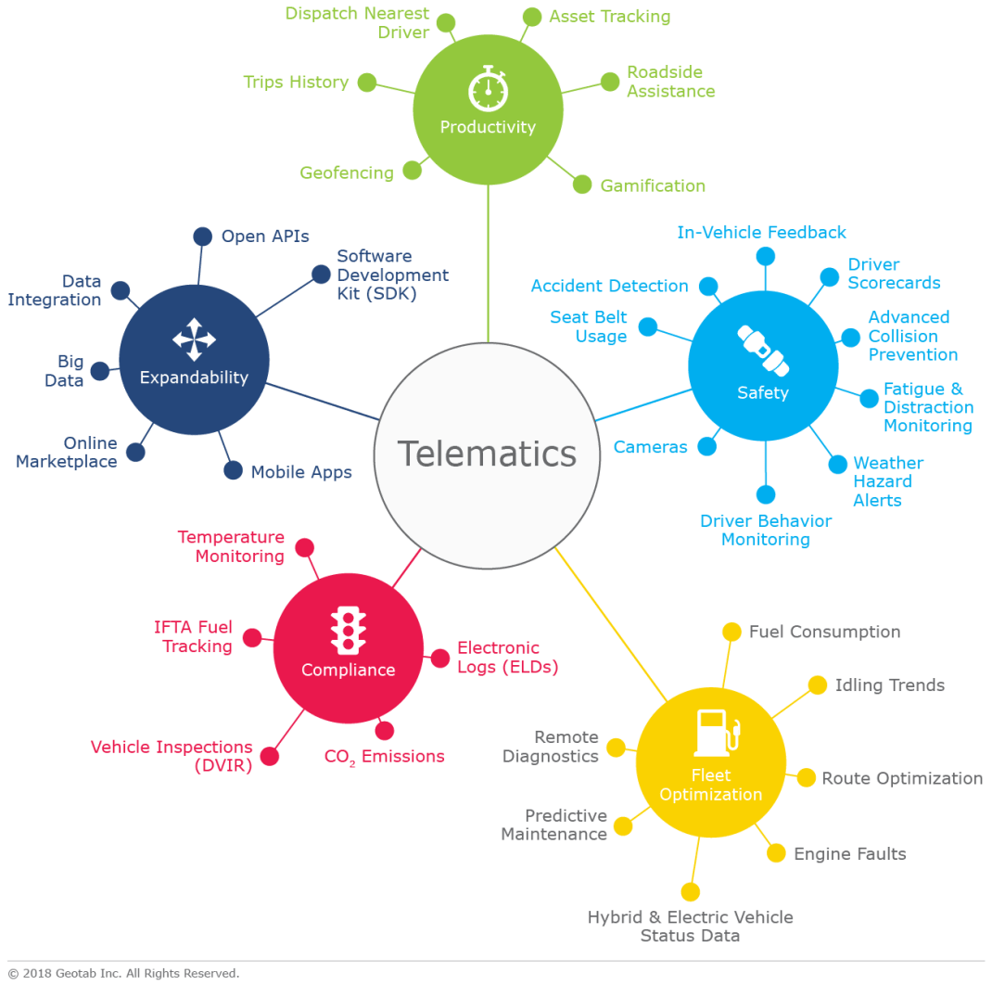
ENABLERS OF REWARD SYSTEMS
Driver Behaviour Monitoring
Driver Scorecards
Notes:
driver behavior monitoring systems for speed enforcement and mitigate theft and the abuse of equipment. Responsible drivers use various driver behavior monitoring apps to work out safer and greener driving habits and decrease fuel costs.
As a rule, tracking driver’s behavior is done using telemetry devices that are installed on vehicles with software to monitor and analyze the device logs.
The number one reason driver scorecards are used is to help improve driver safety and reduce the amount of accidents and claims. In addition to this, scorecards are effective for increasing fleet productivity, improving vehicle health, and increasing compliance or reducing violations.
driving habits, like your driving style, distance travelled, the time of day during which you typically drive, how often you use your phone while driving, and lastly whether you generally obey the speed limits. These factors are used to provide you with a score of how well you’re driving compared to others on the programme, and information on where you can improve if need be.
If the system provides daily, weekly, and monthly scorecards to each driver, as well as in-cab feedback through lights or audio warnings when they exceed nominal threshold behaviors, then the safety team could devise a plan to reward the driver who is modifying his or her driving to be more like the ideal condition. While this is rewarding for “stopping” certain behaviors, it’s also rewarding the adoption of new, positive behaviors. This could include driving gently, shutting off the engine instead of idling when at a long duration stop, and increasing following distance by curbing harsh braking.

Slide 5
REWARDS PROGRAMMES
Accident free Bonus
Premium Discounts
Reward
Points
Notes:
Oldest programme in the market. This encourages drivers to stay claims free and get a bonus at the end of a cycle. Thus encouraging drivers to stay clear of accidents in order to get a bonus, in return reducing the number of accidents.
Safe drivers can earn points for good habits and redeem them for products. an incentive-based driving behaviour programme that rewards clients for improving their driving.In addition, fewer accidents benefit society as a whole, as roads become safer.
Premium discounts apply when a driver maintains a specific driver scorecards and getting refund on portions of their premiums.

Slide 6
Titel hier
SOUTH AFRICAN INSURANCE ASSOCIATION
presented by
John Doe
Date here

