Slide 1
REPORT ON LEARNER TRANSPORT ROAD SAFETY
BY
THABISO MOTLOUNG
GDE LEARNER TRANSPORT DIRECTORATE

Slide 2
ROLES AND RESPONSIBILITIES
PROVINCE | GAUTENG DEPARTMENT OF EDUCATION
LOCATION OF THE FUNCTION | GAUTENG DEPARTMENT OF EDUCATION
DEPARTMENT RESPONSIBLE FOR FUNDING | TREASURY
FUNDING SOURCE | VOTED FUNDS
ROLES AND RESPONSIBILITIES OF DEPARTMENTS IN THE PROVINCE
EDUCATION Identification of schools and learners Identification and approval of routes Provide number of learners to benefit Evaluate the impact of Learner Transport Programme on teaching and learning Monitor and evaluate the Programme Procurement and payment of Service Providers transporting learners | TRANSPORT Establish joint task team through Inter-Governmental Relations structures Provide secretariat support to the joint task team Provide policy drafting expertise to the drafting the Provincial Learner Transport policy Chanel all Transport related matters pertaining to learner transport to relevant departments. COMMUNITY SAFETY Law enforcement and road-worthiness of buses. Testing of buses.

Slide 3
2. PROGRESS ON IMPLEMENTATION OF THE LEARNER TRANSPORT POLICY
Gauteng has a working Learner Transport Policy that is being implemented to the latter. The said policy was reviewed, and the review process was completed in August 2019, the Province is implementing the new policy.

Slide 4
DISTRICT
 | No of learners | TOTAL NUMBER OF PRIMARY SCHOOL | TOTAL NUMBER OF SECONDARY SCHOOLS | TOTAL NUMBER OF SCHOOLS
EKURHULENI NORTH | 2627 | 5 | 8 | 13
EKURHULENI SOUTH | 24725 | 58 | 29 | 87
GAUTENG EAST | 10697 | 28 | 16 | 44
GAUTENG NORTH | 5007 | 16 | 10 | 26
GAUTENG WEST | 20349 | 51 | 27 | 78
JOHANNESBURG CENTRAL | 1183 | 8 | 7 | 15
JOHANNESBURG EAST | 1759 | 1 | 1 | 2
JOHANNESBURG NORTH | 4646 | 4 | 6 | 10
JOHANNESBURG SOUTH | 7525 | 16 | 11 | 27
JOHANNESBURG WEST | 1113 | 5 | 4 | 9
SEDIBENG EAST | 7308 | 21 | 8 | 29
SEDIBENG WEST | 6780 | 22 | 7 | 29
TSHWANE NORTH | 8180 | 9 | 12 | 21
TSHWANE SOUTH | 14110 | 26 | 14 | 40
TSHWANE WEST | 23822 | 33 | 21 | 54
TOTAL | 139831 | 303 | 181 | 484

Slide 5
OVERVIEW OF LEANER TRANSPORT PROGRAMME
New Academic Year
The number of learners transported has grown from 124 752 in 2018, to 139 831 learners in 484 schools across the Province in academic year 2019.

Slide 6
OVERVIEW OF LEARNER TRANSPORT PROGRAMME
Monitoring
Intensifying monitoring of Learner Transport in order to enhance compliance using monitoring tools.
Monitoring continued at school level focusing on Arrival and Departure time of buses, Overloading; and Shuttling.
Monitoring is also conducted at Pick-up points by District Coordinators and Provincial Officials
GDE also relies on the road traffic police for Law enforcement on the road
School visits focused on document verification like L1 forms and registers of learners that are benefiting from the Programme.
Conduct awareness workshops with stakeholders on Learner Transport

Slide 7
MEETING WITH STAKE HOLDERS
Meetings with Stakeholders is held as when required.
Continuous meetings are held on issues pertaining to inspection, testing of buses, monitoring & roadworthiness of vehicles ferrying learners for safety purposes
Steering meetings are held on Learner Transport issues with Gauteng Department of Roads and Transport, Gauteng Department of Community Safety and Gauteng Department of Education. These meetings focused on:
Allocation of Shovhakalula Bicycles
Roads Infrastructure
Testing of Buses that started on 18 June 2019 and ended on 8 July 2019
Safety related issues

Slide 8
Incidents reported
District | No. of districts | No. of schools | No. of operators | No. of incidents / accidents | NUMBER OF:
 |  |  |  |  | Injuries | Deaths
EKURHULENI NORTH | 1 | 2 | 2 | 2 | 0 | 2
EKURHULENI NORTH | 0 | 0 | 0 | 0
EKURHULENI SOUTH | 0 | 0 | 0 | 0
GAUTENG EAST | 0 | 0 | 0 | 0
GAUTENG NORTH | 0 | 0 | 0 | 0
GAUTENG WEST | 0 | 0 | 0 | 0
JOHANNESBURG CENTRAL | 0 | 0 | 0 | 0
JOHANNESBURG EAST | 0 | 0 | 0 | 0
JOHANNESBURG NORTH | 1 | 1 | 1 | 1 | 0 | 0
JOHANNESBURG SOUTH | 0 | 0 | 0 | 0
JOHANNESBURG WEST | 0 | 0 | 0 | 0
SEDIBENG EAST | 0 | 0 | 0 | 0
SEDIBENG WEST | 0 | 0 | 0 | 0
TSHWANE NORTH | 0 | 0 | 0 | 0
TSHWANE SOUTH | 0 | 0 | 0 | 0
TSHWANE WEST | 2 | 3 | 3 | 3 | 0 | 2
TOTAL | 1 | 2 | 2 | 2 | 0 | 2

Slide 9
Testing of buses and Roadworthiness
Buses are subjected to a compulsory roadworthy testing conducted by GDCS at least once per annum during the June/ July school holidays, this initiative started in 2011 and continued to the current academic year. In 2011 when the testing started, only 200/ 1300 buses passed in the initial test (first test), 1100 buses had to be re-tested, in 2013, 800/ 1500 passed the initial test.
And in subsequent years more than half the number of buses passed the initial test thus highlighting the importance of Roadworthy testing and keeping Learner Transport buses safe and reliable. Buses are given opportunities to undergo the re- test and pass to ensure that all busses used for Learner Transport are roadworthy.

Slide 10
Challenges and Mitigation on Testing
Challenges with testing of buses includes among other things:
Challenges | Possible mitigations
Unavailability of testing stations | Extend the testing period over the first three school holidays of the year.
Duplication of vehicles (testing same buses for different service providers) due to branding challenges | As part of the terms of reference for the new tender, branding of buses with company names should be compulsory
Limited testing time and few testing stations/ and officers (only 5 stations were available for more than 2000 buses in 2019) make it impossible for all 2000+ buses to be tested within the 15 days period | Extend the testing period over the first three school holidays of the year and allocations of more testing officials.

Slide 11
LEARNER TRANSPORT AND SAFETY ISSUES ON R24
THE INTERVENTION BY THE DEPARTMENT OF COMMUNITY SAFETY ON R24 ROAD TO MAGALISBERG
The Department of Community Safety conducted a study on R24 road to Magalisberg because of a number of fatal accident along the road
Within R24 Gauteng Department of Education has picked up points
Along R24 road also Gauteng Department of Education has 5 schools of which those learners are currently transported due to the number of fatal accidents along the road
Some of these learners travel 2 to 3 km to school. Of which the distance is not covered by scholar transport policy ,due to the condition of the road those learners were to be transported
As a result of the below accident the Department took a resolution that all route that are along R24 have to be changed .All the routes were then moved to the safe area not near or close the road

Slide 12
R24 ROUTE CHARACTERISTICS
Length=39 km (Game Reserve to NW)
Mostly single lane
Passes through Magalisberg CBD
Dangerous Bends = 41
Schools along R 24 = 5
Major Tourist Locations = 9
Formal Intersections = Over 25
Painted Pedestrian Crossings = 3
Major of route has no Street Lighting
Continuous hilly terrain with bends
2Major Informal Settlements
Several Farming and small Business establishment along R24.

Slide 13
COUNTING STATION DATA
Average Daily Traffic Count:
Over 10 000 Vehicles per day
(Between Magalisberg and D400)
% Heavy Vehicles:21% (2,137 vehicles daily)
% Night Traffic (18:00 to 06:00):24% (2440mv)
Vehicles with less than 2 seconds following distance: 23%
Peak Hour Traffic
WEEKDAY 7:00 to 08:00 &15:15 to 16:15
SATURDAY:10:00 TO 11:00

Slide 14
ER 24 FINDINGS
LEARNER TRANSPORT SAFETY
Ineffective speed calming at school entrances.(Also Lack of Speed Law Enforcement during School Start / Ending Times)
Overcrowding / overloading
No safe pick-up areas (bus stop areas)
Lack of sufficient points men at some pick-up areas
Risk when turning at School areas (Approaching Vehicles Speeding)
Collision Contributory Factors
Pedestrian & Cyclist Collisions
Common Jaywalking / Crossing Unsafely
Lack of safe areas
Drivers not giving right of way at designated Crossing areas
and Intersections
No Street Lighting.
Drunken Pedestrians
Not wearing bright clothing at night / dusk / dawn
Drivers do not obey 60 km/h speed limits at busy pedestrian areas, eg.Tarlton (Matsepa)

Slide 15
ER 24 FINDINGS CONTINUES
Engineering Factors
Poor condition of Road Shoulders / pull of areas.
No Cat Eyes especially at bends.
Constantly changing SPEED LIMITS over short spaces ,eg. 100,80,60,100,60,80,120,60 etc.
Halfway / Ineffective Speed Calming at pedestrian crossing and Intersections.
Too many Intersecting roads that are not conductive to safe exit / entering of the R24

Slide 17
R24

Slide 18
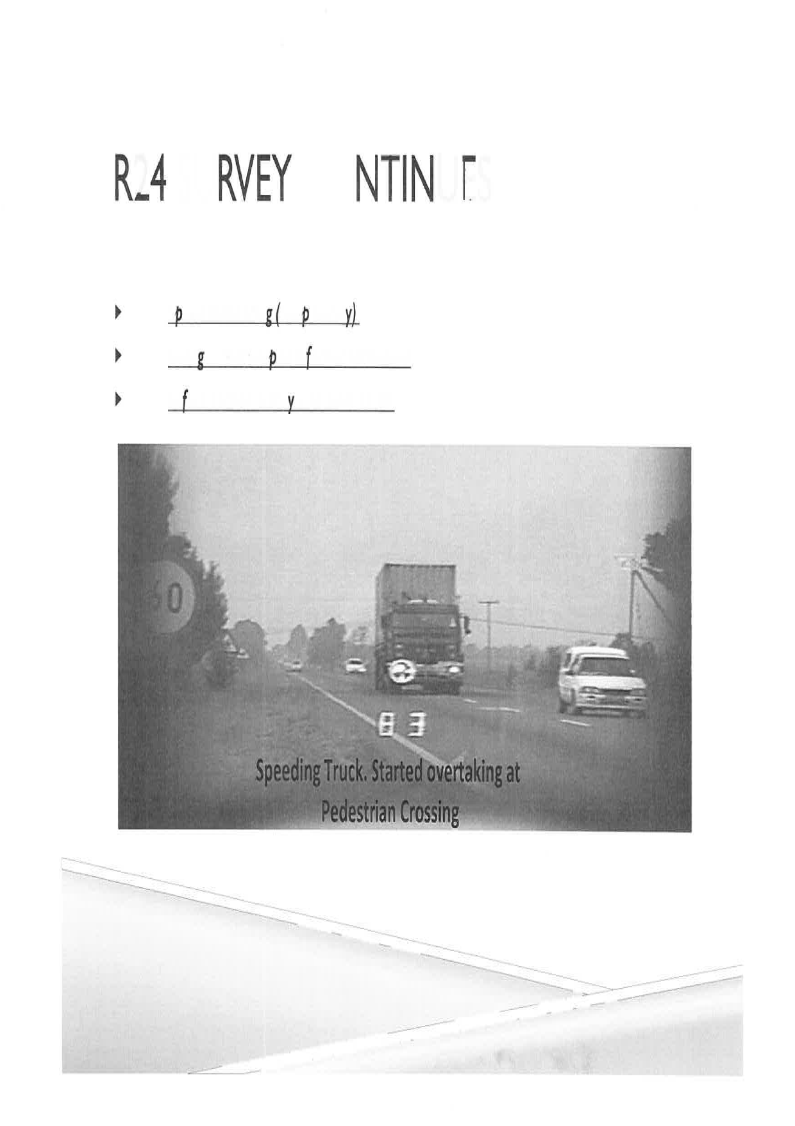

Slide 19
PETIT HIGH SCHOOL STUDY ON ROAD SAFETY
The request was made to GTP to facilitate interventions regarding unsafe conditions outside Petit High School located on Zesfontein road, a road inspection was conducted on the 21st May 2019. Traffic patterns and road user behavior was assessed during both the school starting and dismissal times.
The afternoon observations were conducted by GTP, GDE and GPDRT representatives.
further assessment was conducted on the road environment along the +-1.2km length of Zesfontein Road at the following intersecting roads: a. M44 Pretoria Road (Northern and Southern Y-Junction
Information obtained from interviews with the staff at Petit High School indicates that the safety risks experienced by learners and educators was previously communicated to City of Ekurhuleni and EMPD. Relevant petitions and letters requesting safety improvements were not responded to over several years. The school was also unsuccessful in attempts to institute a scholar patrol. The only evidence of intervention was a faded pedestrian crossing and damaged warning sign.
Due to the severity of some of the risks, eg. degraded road surface and children pedestrians exposed to danger from passing vehicles, several of the items were logged on the My Ekurhuleni app and via twitter to the @CoE_Call-Centre handle.

Slide 20
PETIT HIGH SCHOOL STUDY ON ROAD SAFETY….
The following reference numbers were provided from the twitter complaints 3669491, 3669503, 3669516.
Surprisingly it was found on the next day (22nd May 2019) that 2 speed humps were installed overnight in front of Petit High School.
A further follow up assessment was conducted on 27 May 2019 to inspect the Speed humps, the impact on traffic flow and any outstanding risks.
Summary of Road Environment Risks requiring intervention: a. Repair dangerous potholes, edge breaks, “sunken” road sections and rutted road shoulders.
Installation of High Visibility advance warning signs for : i. Speed Calming
ii. School Zone.
iii. Blind bend
iv. 3-Way Intersection

Slide 21
PETIT HIGH SCHOOL STUDY ON ROAD SAFETY
Road markings.
d. Widen the narrow sections of the road where lane widths are less than 3.1m despite mixed traffic patterns involving Heavy vehicles transporting dangerous goods,eg. fuel, travelling simultaneously on opposing sides of the roadway
e. Create safe pedestrian pathways to accommodate the needs of school leaners and pedestrians accessing several small shops.
f. Widen the existing Speed humps to extend into the road shoulders. This is to prevent driving around the speed hump.
g. Completion of 3rd Speed Hump next to the school
h. Transform the intersection of Zesfontein Road and M32 Birch Road into a 3-way STOP
(NB: average width of a truck tractor is +-3.1m including the mirrors. Standard minimum lane width for identified traffic use is 3.7m)
NB: Recommendation is for Speed Humps to be at least 3m in length and 12 m wide with a

Slide 22
PETIT HIGH SCHOOL STUDY ON ROAD SAFETY….
Safety improvements to the 4-way intersection of M44 Pretoria Road and Peenz Street:
i. Convert into a 4-Way STOP
ii. Improve Speed Calming measures
iii. Clear obstruction on road shoulders to improve sight distance (eg. long grass, trees)
especially around the curve.
Below are relevant photos / images of the area being referenced.

Slide 23
PETIT

Slide 24
PETIT

Slide 25
PETIT

Slide 26
PETIT

Slide 27
PETIT

Slide 28
PETIT

Slide 29
PETIT

Slide 30
PETIT

Slide 31
PETIT

Slide 32
PETIT

Slide 33
PETIT

Slide 34
PETIT

Slide 35
PETIT

Slide 36
THANK YOU

