Slide 1
Gauteng Department of Department of Infrastructure Development Implementation of Provincial Priorities 10 November 2020

Slide 2
Introduction
COVID-19 impact on project performance
Interventions to improve performance
The COVID-19 pandemic has added to the construction industry’s challenges, with projects being halted by the pandemic and the subsequent nation-wide lockdown. Due to delays, projects may potentially run over the prescribed time of delivery, with significant cost overruns.
Adherence to the IDMS across the infrastructure planning and delivery chain by addressing inconsistencies and inefficiencies, in order to improve the State’s capacity to deliver on infrastructure;
This will ensure that the department shift from a project-based (sector/silo) approach to a portfolio or programme multi-sectoral approach across all spheres of government and stakeholder groupings;
Improve government immovable asset portfolio to generate revenue by focusing on a preventative maintenance programme that is in line with best practice lifecycle asset management principles and practices;
The need to explore feasible budget solutions to reduce delays in the payments to service providers.

Slide 3
High level impact departmental impact due to COVID-19
COVID-19 pandemic had a significant social and economic impact that goes beyond the public health system, GPG formulated its COVID-19 Response Plan and DID implemented measures to ensure continuity in the planning, design and delivery of infrastructure.
The impact of the national state of disaster and the nation-wide lockdown resulted in a need to review departmental plans, to ensure that plans respond to the COVID-19 pandemic and continued service delivery in the 2020/21 financial year.
The Department established COVID-19 Steering Committee in compliance with the DPSA Circular 15 of 2020, whose focus is on implementing measures to mitigate the spread of the virus, while sustaining the service delivery commitments of the Department.
Construction sites had to be closed under level 5, however, construction services for Covid-19 health projects had to continue . Beyond level 5 other construction projects resumed, with broad economic impacts on suppliers.

Slide 4
Outcome 1: Facilities and Maintenance Management: Functional, reliable and compliant infrastructure
Outcome | Outcome Indicators | Baselines | Targets
 |  |  | Y1 | Y2 | Y3 | Y4 | Y5 | 5 Yr Target
Facilities and Maintenance Management: Functional, reliable and compliant infrastructure | Number of Prioritised¹ Hospitals with a condition-based assessment rating of at least 3 or above | 0 | - | 1 | 2 | 3 | 4 | 10
 | 2. Number of Gauteng Provincial Government (GPG) hospitals that are compliant with OHS regulations | 0 | Finalise OHS Work Packages Advertise Tender | 1 Site handover Initiate Construction | 3 | 10 | - | 14² of the 32 GPG hospitals that are compliant with OHS regulations
1. The 10 prioritised hospitals are: Bheki Mlangeni Hospital, Jubilee Hospital, Mamelodi Hospital (Excluding Gateway Clinic), Tambo Memorial Hospital, Tembisa Hospital, Edenvale Hospital, Dr George Mukhari Hospital, Kopanong Hospital, Sebokeng Hospital and Thelle Mogoerane Hospital.
2. The target of 32 hospitals that are compliant with OHS regulations, is informed by budget allocations and the construction duration to implement projects. The 14 hospitals will be completed within the term and the remainder will be completed after 2024/25 Financial years

Slide 5
The 10 Prioritised Hospitals with a condition-based assessment rating of at least 3 or above
Progress to date:
Procurement tenders for the remaining hospitals, (that have work focusing on not only OHS issues but overall infrastructure maintenance including, refurbishments etc which will together improve the overall conditional assessments ratings) 08 Hospital has been advertised, Namely:
Carletonville, Sterkfontein, Yusuf Dadoo & Leratong – Advertised on the 13th December 2019
Dr George Mukhari Academic and Jubilee – Advertised on the 21st August 2020
Weskoppies and Bheki Mlangeni – Advertised on the 09th October 2020
Key Next Steps
To fast track the advertisement of the remaining seven of the 10 priority hospitals

Slide 6
Number of GPG hospitals that are compliant with OHS regulations
Key Performance Indicator | 2019/20 Reported data |  | 2020/21 Current status |  | 2024/25
 | Target | Actual | Target | Actual | 5 YEAR TARGET
Number of Gauteng Provincial Government (GPG) hospitals that are compliant with OHS regulations | Finalise OHS Work Packages Advertise Tender | 4 hospitals has been advertised. 4 in Western corridor (Carletonville, Sterkfontein, Dr Yusuf Dadoo & Leratong Hospitals) | Site handover Initiate Construction | Tender has been advertised, and the site briefings in progress 4 hospitals has been advertised to date. 3 in Northern Corridor (Dr George Mukhari, Jubilee & Weskoppies) 1 in central corridor (Bheki Mlangeni) | 14 of 32 GPG Hospitals that are compliant with OHS regulations
Key Next Steps
To fast track the adjudication process of the 4 hospitals in West Rand , namely: Carltonville, Sterkfontein , Yusuf Dadoo and Leratong Hospitals.

Slide 7
Outcome 2: Property Management: Optimised public owned fixed property portfolio (to transform property market)
Outcome | Outcome Indicators | Baselines | Targets
 |  |  | Y1 | Y2 | Y3 | Y4 | Y5 | 5 Yr Target
Property Management: Optimised public owned fixed property portfolio (to transform property market) Owner: DDG: Education & acting CD: Property Management | Number of GPG departmental head offices accommodated in Grade B quality-rated GPG-owned buildings (within the Kopanong Precinct) | 0 | Receive Treasury Approval II(a) & TA II(b) | Treasury Approval III and Procurement | Construction phase | 8 | 6 | 14 GPG departmental head offices accommodated in Kopanong
 | Number properties released for socio-economic infrastructure development or commercialisation³ | 0 | Property Profiling, compilation of draft RFP docs and initiate procurement process | 3 | 4 | 6 | 6 | 19
3. The strategy seeks to utilise the current GPG property portfolio to transform the property market

Slide 8
GPG departmental head offices accommodated in Grade B quality-rated GPG-owned buildings
Key Performance Indicator | 2019/20 Reported data |  | 2020/21 Current status |  | 2024/25
 | Target | Actual | Target | Actual | 5 YEAR TARGET
Number of GPG departmental head offices accommodated in Grade B quality-rated GPG-owned buildings (within the Kopanong Precinct) | TA I approval TA II approval | Revised the feasibility and affordability report and submitted to Provincial Treasury for approval | Receive Treasury Approval II(a) & TA II(b) | Concept document developed Discussions with COJ leadership ongoing The Tender for Clusters 1,3 and 4 were closed and Bids received on the 31st August 2020. Cluster 2 closed on the 30th September 2020 | 14 GPG departmental head offices accommodated in Kopanong Precinct
Key Next Steps
SCM will commence with Evaluation Process until December 2020.

Slide 9
Socio-Economic Objectives of the KPP as an Adaptive reuse Project
KPP Bid Status
Economical
Environmental
Social
Heritage/
Cultural
Bids for Cluster1,3 &4 closed
On the 31 August 2020 and
Cluster 2 Closed on the 30th
September 2020. Bids
evaluation is in process.
Evaluation completion will
enable submission of TAIIB and
Subsequent winning bidder
Announcement and contracting.
The project is on course.
Environmental Management
Energy efficiency, Extending LC for buildings, materials and resources, Reduction of landfills demolition waste, Reduce GHGs, reduce resources consumption, Recycling building materials
Improvement of quality of life
Healthy & Hospitable Environment for govt officials, Enhance city’s resilience and sustainable profile, Provide safe and healthy environment,
Public Environmental Awareness
Contribution to cultural practices and knowledge, Create public awareness of Adaptive reuse projects
Economic growth
Creating jobs, Increasing Property values, Market creation, Growing investment
Tourism Growth
Promotion of Cultural tourism, Enhance inner city attractiveness and competitive profile
Local memory and cultural identity preservation
Enhancement of precinct building aesthetics, maintain local architecture, Retention of visual amenity and identity
Community Empowerment and Involvement:
30% of the total budget to be spend on emerging contractors, Precinct will become a cultural site that inspire people and provide for agglomeration of government services
Local Value Enhancement:
KPP as an adaptive reuse project will bring variety of character and sense of security in the inner city and thus creating demand for properties in the catchment area
Land Conservation against urban Sprawl:
Reduce land use, Prevent Urban Sprawl, Reduce city sprawl
Cultural Heritage Protection
Provides heritage and architectural preservation

Slide 10
Outcome 3: Economic development and jobs creation: Enhanced contribution of infrastructure spend to socio-economic development
Outcome | Outcome Indicators | Baselines | Targets
 |  |  | Y1 | Y2 | Y3 | Y4 | Y5 | 5 Yr Target
Economic development and jobs creation: Enhanced contribution of infrastructure spend to socio-economic development | Number of Direct jobs created in the construction sector by Public Provincial Projects | 0 | 974 | 650 | 710 | 840 | 808 | Direct jobs: 3 528
 | 2. Number of emerging black firms empowered though GPG Projects for contracts above R30 million | New | 5 | 10 | 15 | 15 | 5 | 50

Slide 11
Direct and Indirect jobs created in the construction sector by Public Provincial Projects
Key Performance Indicator | 2019/20 Reported data |  | 2020/21 Current status |  | 2024/25
 | Target | Actual | Target | Actual | 5 YEAR TARGET
Number of Direct jobs created in the construction sector by Public Provincial Projects | 520 | 469 | 650 | 4452 | Direct Jobs: 3 528
COVID-19 and Other Construction Projects | No of Jobs | Labour/Employment Equity |  |  |  | SMME Sub- contractors | Expenditure
Total | 3704 | 323 | 2306 | 908 | 13 | 154 | R 131 403 551,95

Slide 12
Expanded Public Works Programme work opportunities created through GPG Departs and Municipalities
Key Performance Indicator | 2019/20 Reported data |  | 2020/21 Current status |  | 2024/25
 | Target | Actual | Target | Actual | 5 YEAR TARGET
Number of Expanded Public Works Programme work opportunities created through GPG Departments | 47 206 | 31 685 | 44 792 | 21 092 | 225 000
Key Performance Indicator | 2019/20 Reported data |  | 2020/21 Current status |  | 2024/25
 | Target | Actual | Target | Actual | 5 YEAR TARGET
Number of Expanded Public Works Programme work opportunities created through GPG Municipalities | 53 717 | 24 076 | 54 752 | 10 182 | 275 000

Slide 13
Growing Gauteng Together
Expanded Public Works Programme work opportunities created through GPG Municipalities
Narrative explaining the none achievement of the planned target A number of departments and municipalities experienced delays in implementing projects due to the lockdown regulations however sites have been opened for construction and there is progress in terms of work opportunities reported. Key Next Steps Implementation of projects is slowly increasing, and the number of work opportunities reported will increase in the next reporting period.

Slide 14
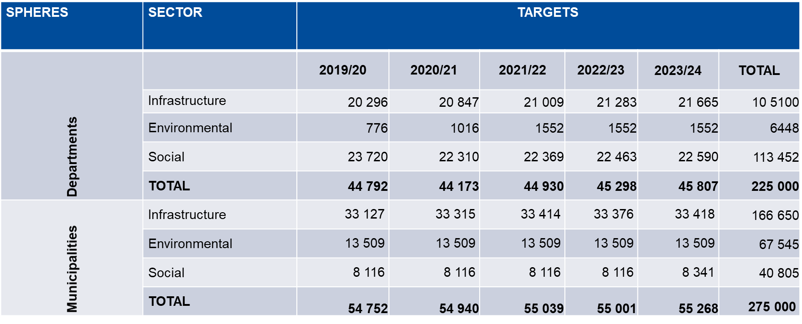
Growing Gauteng Together
Provincial targets across all sectors( 2019/20 – 2023/24 financial year)

Slide 15
Sustainable Infrastructure Development
Context for sustainable Infrastructure Development is defined through interventions identified through GGT2030 including the following:
Promoting sustainable planning and development in the context of a rapidly urbanising region and growing population.
Proactively confronting climate change through management, mitigation and adaptation strategies.
Climate change has resulted in frequency of strong storms, flooding, high temperatures and associated buildings damage.
Preventative solutions include deployment of green energy solution, green design solutions and water saving/harvesting solution that reduces GPG carbon foot print.
Readiness for rapid response to limit the impact of storms and flooding of facilities.
Strengthen infection prevention and control through maintenance interventions and design solutions
Sustainable Development: infrastructure investment and development to appreciate long term implication, resources limitations and need for resources optimisation.
Refinement of asset register through ascertaining legal compliance of all facilities, their condition and subjecting them to mandatory planned maintenance programme.
Assessing dolomite risk exposure of the entire property portfolio based on the geo location and Council for Geo Science records.
Above two intervention are part to an integrated condition assessment.

Slide 16
Implementation of Infrastructure Plans
DEPT | Programme | No | Planning | Works | Closeout
GDE (203) | New Schools | 35 | 23 | 4 | 8
 | Upgrades and Additions | 32 | 26 | 2 | 4
 | Restoratives Repairs | 136 | 89 | 20 | 27
COGTA (1) | IPDMC | 1 | 1 | 0 | 0
DSD (14) | Child Youth Care Centres | 2 | 1 | 1 | 0
 | Early Childhood Centres | 3 | 1 | 2 | 0
 | Social integrated Facilities | 3 | 2 | 1 | 0
 | Shelters For Vulnerable | 1 | 1 | 0 | 0
 | Aged Day Care Centres | 1 | 1 | 0 | 0
 | Rehab Centres | 4 | 4 | 0 | 0
DID | OHS | 12 | 6 | 3 | 3

Slide 17
Implementation of Infrastructure Plans
DEPT | Programme | No | Planning | Works | Closeout
DRT | DTLC | 1 | 0 | 1 | 0
 | Intermodal Facility | 1 | 1 | 0 | 0
GDARD | Water Supply upgrade | 2 | 1 | 0 | 1
DSACR | Libraries | 6 | 0 | 4 | 2
 | Memorials | 2 | 0 | 0 | 2
 | Sports facility | 1 | 0 | 0 | 1
E-Gov | Tenant Installation | 1 | 1 | 0 | 0
Gfleet | Upgrades | 1 | 0 | 1 | 0

Slide 18
Implementation of Infrastructure Plans -Hospital
DEPT | Programme | No | Planning | Works | Closeout
GDOH Hospitals | New and Replacement Assets | 5 | 1 | 4 | 0
 | Upgrades and Additions | 3 | 2 | 1 | 0
 | Rehabilitation, Renovation and Refurbishments | 19 | 16 | 1 | 2
 | Total | 27 | 19 | 6 | 2
DEPT | Programme | No | Planning | Works | Closeout
GDOH Other Health | New and Replacement Assets | 19 | 6 | 10 | 3
 | Upgrades and Additions | 3 | 0 | 2 | 1
 | Rehabilitation, Renovation and Refurbishments | 1 | 0 | 1 | 0
 | Total | 23 | 6 | 13 | 4
The Department is implementing a total of R4,4 billion for infrastructure for client departments

Slide 19
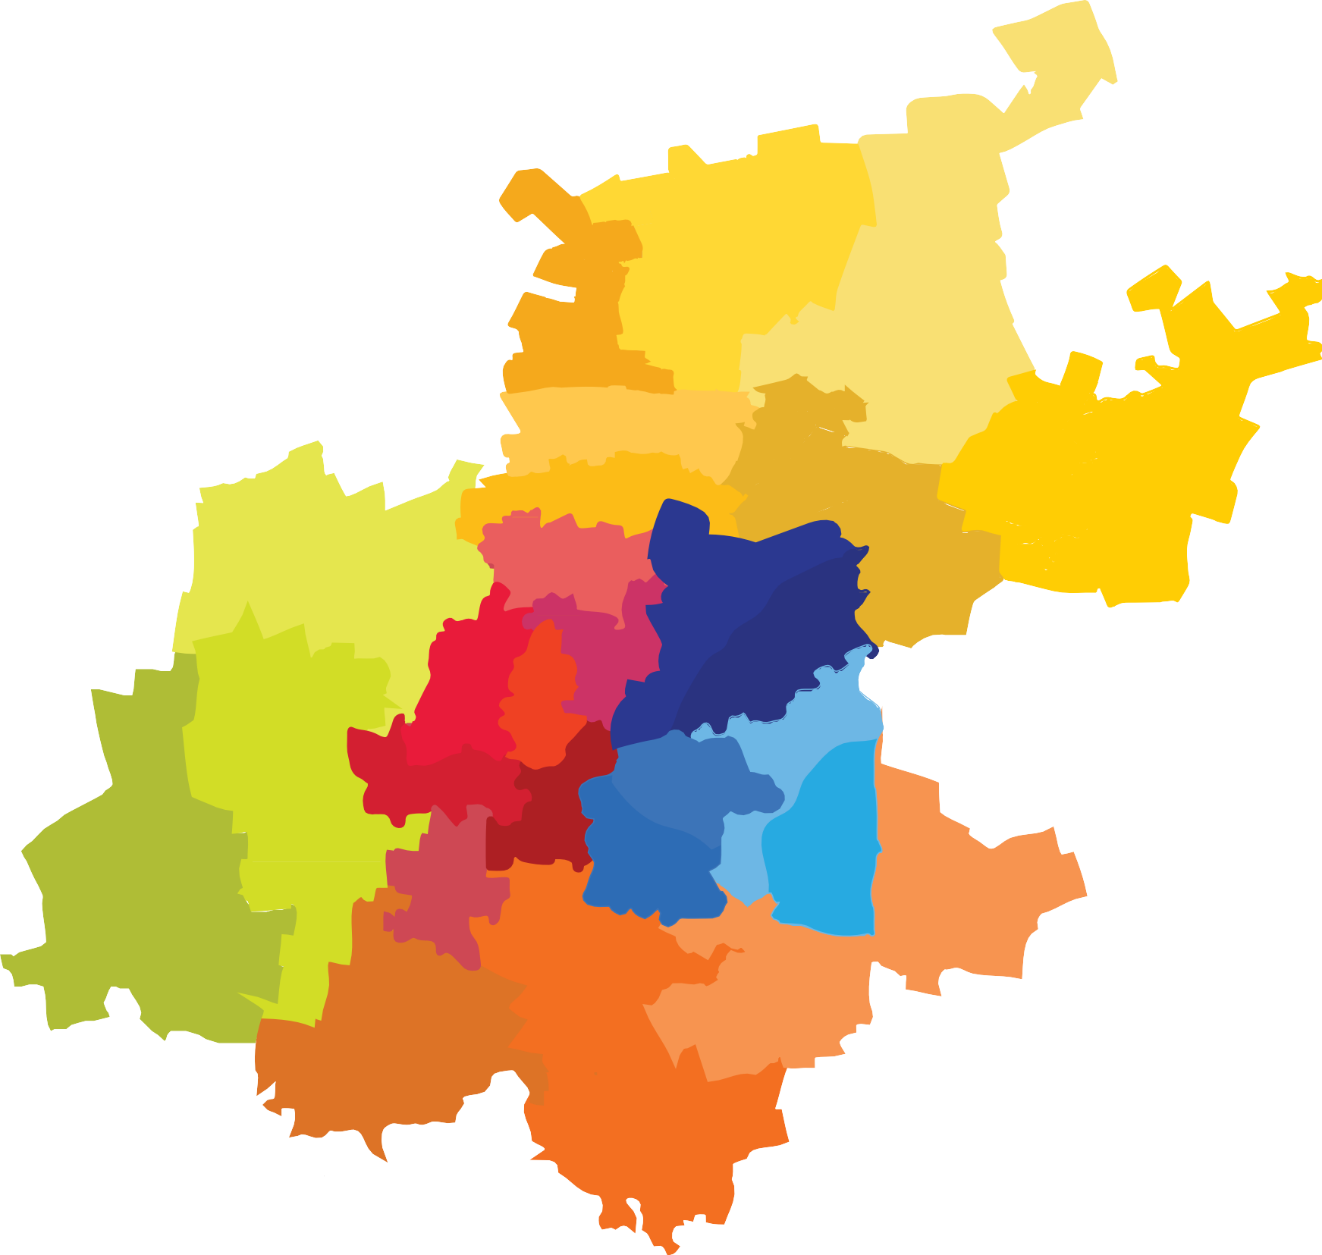
COVID-19 INFRASTRUCTURE PROJECTS
General Beds
High Care and ICU
Dr George Mukhari
15
Tembisa Hospital
68 Beds
Tshwane District Hospital
40 Beds
Lenasia South Hospital
103 Beds
Discoverers CHC
74 Beds
Dr George Mukhari
601 Beds
Jubilee Hospital
300 Beds
NASREC Field
1 000 Beds
NASREC Quarantine
500 Beds
Tembisa Hospital
10 Beds
Helen Joseph Hospital
10 Beds
Kopanong District Hospital
345
Charlotte Maxeke Hospital
55 Beds
Anglo Ashanti Hospital
175
Chris Hani Baragwanath
604

Slide 20
New and Replacement Schools
Project Stage in progress | Count | Names
Inception | 8 | Eesterust,BirchAcres,Itireleng, Mcbain Charles,Leihlo,Wilheminah Hoskins,Riverlea ,Rietvallei Ext1
Concept and Viability | 2 | Gillview,Savannah
Design Development | 9 | Roodekop, Reigerpark Westonaria Borwa, FredMagardie,Durban Deep,Phomolong,Barcelona,E.W Hopps,Mdelwa Hlongwane,
Detail Design | 2 | Simunye,Rotara
Procurement | 2 | Dr W.K Du Plessis,Sizuzile
PEP v5 Works | 4 | Rustervaal,Braamfischer,Nancefield,Mayibuye
PEP v7 Close Out | 8 | Nellmapius,Braamfischer,Moses Kotane,Julius Sebolai,Nkone Maruping,Nokuthula,Noordgesig,Oosrand
Grand Total | 35

Slide 22
Overall Infrastructure Project Pipeline by Stages
Overall Infrastructure Pipeline by Stages (Projects & Maintenance)
Identification & Feasibility
Detailed Design
Procurement
Construction/
Execution
Handover / Close-Out
526
282
98
473
33
10.7%
31.8%
11.1%
53.4%
3.7%
INITIATIVES =526
PROJECTS = 886
Other * = Cancelled, Non Infrastructure, Terminated, Delayed, Blank
Overall “Projects”
Received
Notes
E-Gov – The GBN Phase 2 project is to be rolled out at 2012 sites
Human Settlements – has 3064 nr. of projects with no status
4926
3513
71.3%
OTHER = 3513
**Note: Overall Pipeline includes Projects and Maintenance Projects

